Slide 1
Report on Image Style transfer using CNN

Slide 2
Problem
Computers have the ability to recognize an object or an image due to development of DL models can that be able to train the computers to do the task.
So , Far there isn’t any algorithm which does the task of creating artistic images of high perceptual quality by the computers.
Now we need an algorithm, with which computer can create artistic images of high quality same as that of created by human artists.

Slide 3
STATERGY
The authors in the paper had developed a system based on neural networks for creating artistic images.
The system uses neural representations to separate and recombine style, content of different images.
So we need to generate images having content matching with one image with the style of another.

Slide 4
Why NN FOR THE TASK ?
We need to mix the content of one image with the style of another .
Content of image can be extracted by taking the high level image features .
When we take a CNN model trained for object recognition , while going through the levels input image is transformed into representations that contain the content of input image and they don’t contain the actual pixel representations of the image.
So while using CNN , we can get high level image features which represent the content of the image .

Slide 5
Why NN FOR THE TASK ?
Authors had also built a representation for representing the style of the image. They use a feature map which is built on the top of filter responses of each layer .
It contains the correlations between different filter responses. By these feature map we can capture the texture information of the image not the global arrangement.
Therefore authors also found that using CNN models for the task is beneficial.
Authors had used VGG – 19 Model for the task.

Slide 6
Why & what is vgg-19 model ?
VGG – Visual Geometry Group consist of blocks , where is each block contains some CNN , Max pool layers . VGG comes up with two modules VGG – 16 , VGG -19 containing 13 , 16 convolution layers with 5 pooling layers.
VGG is one of the most popular image recognition architecture. VGG - 19 had achieved highest accuracy of 94.52 % , VGG - 16 had achieved a highest accuracy of 83 %.
As we need a pre model which is used for object classification for style transfer , for further improving the accuracies we can take pre trained VGG model for the task of stylizing the images.

Slide 7
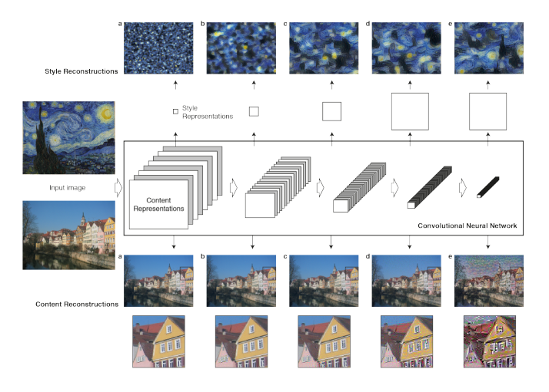
visulizations of content & style
Here from the picture , In content reconstructions while going along the layers , we get the image which actually care about the global representations of the image but not the exact pixel values of image.
In style reconstructions while going along the layers , we get a more appealing and continuous distribution of colors.

Slide 8
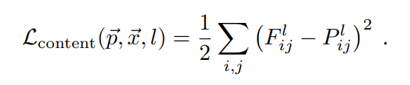

Content representations
For matching the content of output image with the content of one of the input image , we minimize the loss function between the feature map outputs of the input image and output image.
Let p, x be the original image & output image respectively. Now the loss function between feature map outputs of original image and output image at layer l is given by

Slide 9
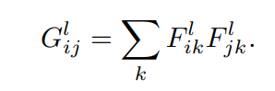
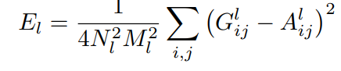
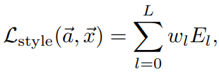
Style representations
For getting style representations we use feature space built on the feature map outputs. The feature correlations are given by Gram matrix G .
Let a, x be the original image & the image that is generated .Now the loss function between the gram matrices of original image and output image at layer l is given by
Total style loss is given by , where w_l is the weight for each layer.

Slide 10
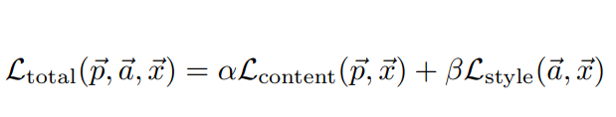
Style transfer
We need to transfer style of art image a to the content of image p to generate an output image x.
There is always tradeoff between style and content . The total loss of the output image with respect to the two input images given by
Where alpha , beta are the weighting factors for content and style . Now we minimize the loss total by taking gradient of Loss_total wrt output image .
So we optimize our output according to the gradients by various optimization techniques.

Slide 11
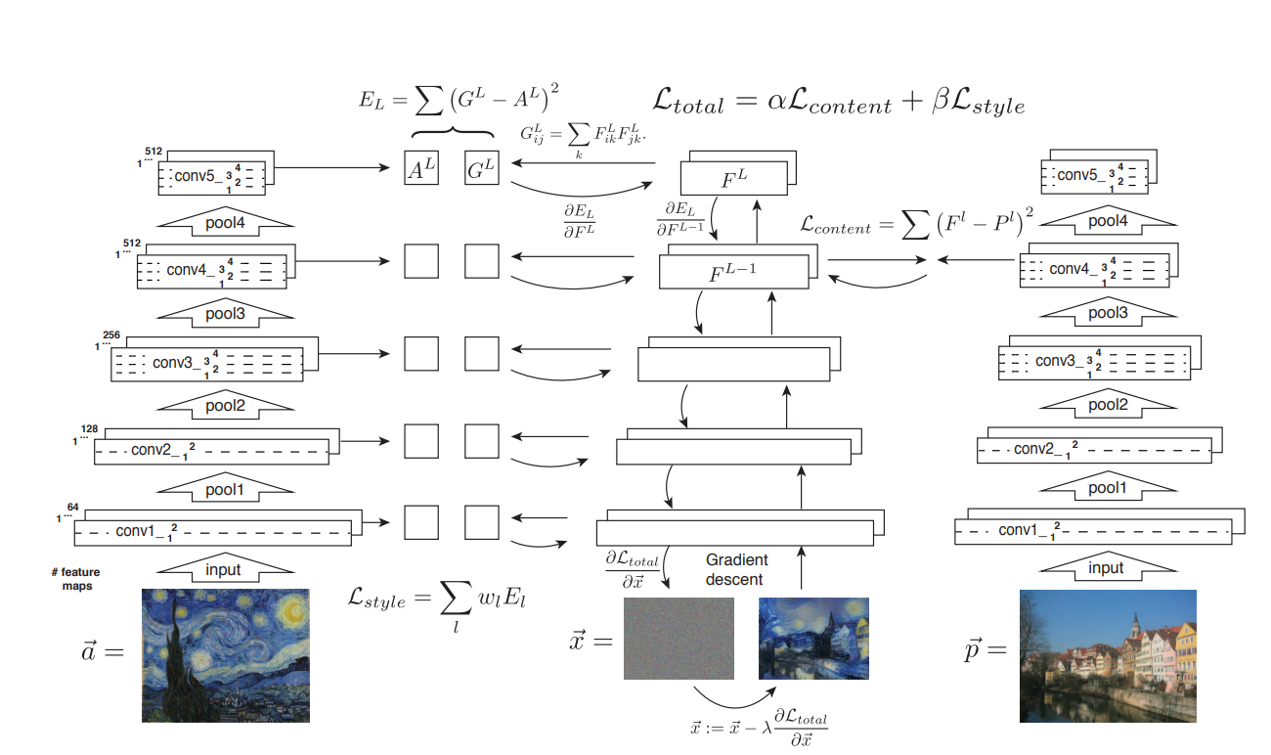

Slide 12
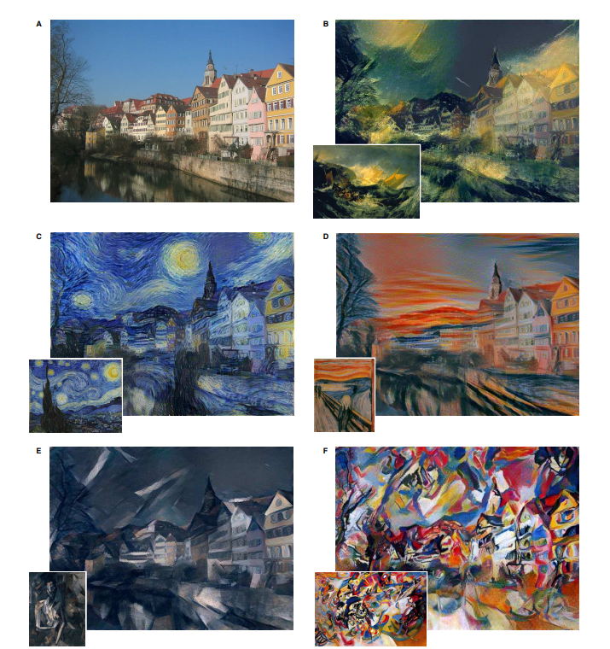
Results/OUTPUTs
Here from the left we can see the content image represented as image a.
Where we generated stylized images whose content matches with image a & their style matches with the small image which was in b,c,d,e,f.

Slide 13
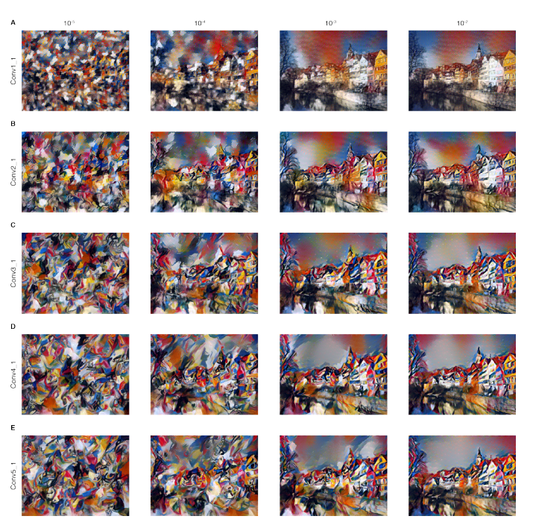
Trade off between style & content
By changing the weight parameters α & Ꞵ , we get different types of stylized images. With high ratio of α/ Ꞵ results an image having high percentage content matching wrt to the original image. Low ratio of α/ Ꞵ will result in having more style matching wrt to original style image than the content image.

Slide 14
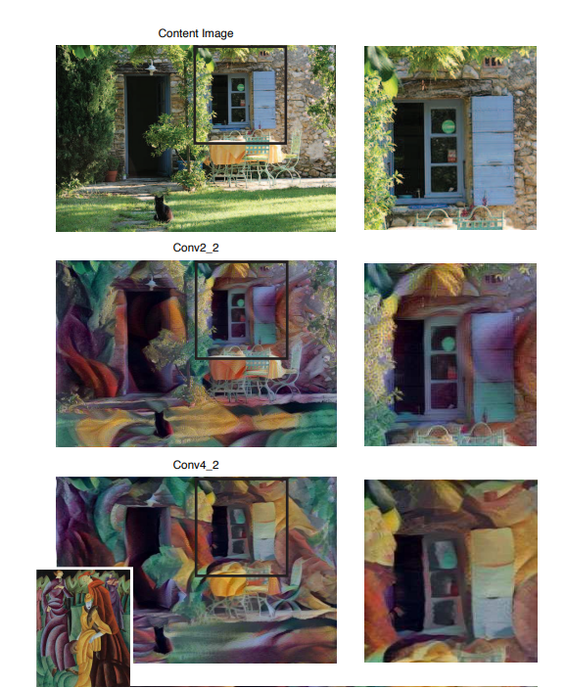
Effects of various layers in cnn on the output image
While matching style , content in various layers of CNN. In the lower layers detailed pixel value of the image will still be preserved in the image. Conv 2_2
While matching till the highest layers we only get the content of the image not the pixel value and also for the style we get more continuous , visually appealing colors leading to high quality images. Conv 4_2

Slide 15
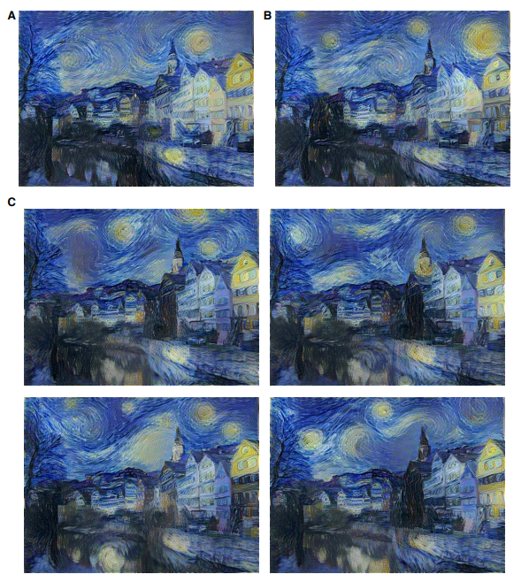
Initialization of gradient descent
Actually , we initialize the output image with white noise image i.e. we do without showing any bias to style or content.
But we can also initialize it with content or style images. Then the results will be dependent on the initialization .
Image A is initialized with content image. Image B is initialized with style image . 4 Images C are initialized with white noise.

Slide 16
limitations
This Neural network based algorithm had some limitations.
When the image resolution increases , the size of optimization problem and the complexity increases . With images of size 512 x 512 pixels , synthesis of stylized images will take upto 1 hour on Nvidia K 40 GPU. So this is one of the major limitation for the algorithm.
Sometimes synthesized output images are subject to low-level noise.

